Slide 1
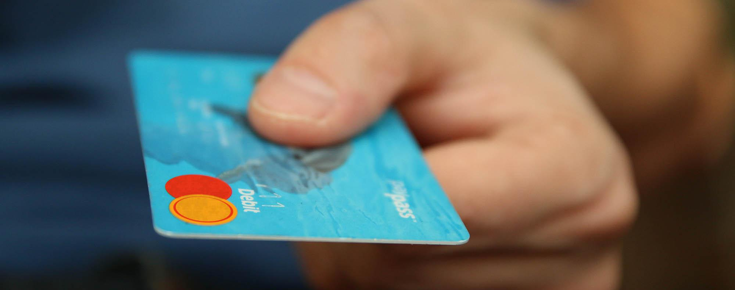

Securing ATM Transactions with Facial Recognition-Based Verification Systems

Slide 2

PROJECT REVIEW - 03
OASYS INSITITUTE OF TECHNOLOGY
A Presentation On
Securing ATM Transactions with Facial Recognition - Based Verification Systems
by guide name
Nilavarasu.M (812921104022) Mrs.A.Priyanka ( B.E , M.E ),
Nishardeen.U (812921104023)
Nivetha.S (812921104024) Computer Science Department.
Prasanna.M (812921104026)

Slide 3
Objective
Aim
The Aim of this project is to proposes the alliance of Face Recognition System for authentication process,
unknown face forwarder URL and enhancing the security in the banking region.
Objective
To provide more security in the ATM.
To avoid various types of criminal activities.
To verify the identity of unauthorized user.
To prevent unauthorized access using Face verification Link.
To prevent theft and other criminal activities.

Slide 4
Problem Definition
Traditional ATM authentication methods face challenges in ensuring robust security while maintaining user convenience. PINs and card-based systems are susceptible to unauthorized access and fraud.
Security Concerns: Traditional methods are vulnerable to card skimming, PIN theft, and unauthorized access, leading to potential financial losses and identity theft.
User Experience: Current authentication processes may not offer the optimal balance between security and user convenience, leading to potential frustrations for users.
Fraudulent Transactions: The rise in sophisticated fraudulent activities demands an advanced authentication system to prevent unauthorized transactions.

Slide 5
Literature Survey
Title | Author & Year | Methodology | Key Contribution
On Reinforcing ATM Transaction Authentication Security Process by Imposing Behavioral Biometrics | Prakash Chandra Mondal, Rupam Deb, Md. Nasim Adnan (2017) | Behavioral Biometrics, Online Handwriting Signature Verification, Chip-based Card, PIN-based Three-Factor Authentication | Enhanced ATM security using behavioral biometrics (online signature) to avoid costly physical biometric data upgrades.
Enhanced Biometric Template Protection Schemes for Securing Face Recognition in IoT Environment | Alamgir Sardar, Saiyed Umer, Ranjeet Kumar Rout, Kshira Sagar Sahoo, Amir H. Gandomi (2024) | Cancelable Biometrics, Bio-Cryptography, FaceHashing, Sliding-XOR, EPS, TSPM, SVM | Proposed a secure face recognition system for IoT using cancelable biometrics and S-XOR-based cryptographic protection.
A Novel Method to Enhance the Security of ATM Using Biometrics | G. Renee Jebaline, S. Gomathi (2015) | Biometric Authentication (Fingerprint, Retina), Image Matching with Database, Pin Replacement | Proposed replacing PIN-based ATM authentication with biometric-based access for increased transaction security and reduced fraud.

Slide 6
Existing System
1. Existing ATM authentication method is the use of password-PINs and OTP.
2. QR cash withdrawals were enabled so customers could ditch their ATM cards and simply scan a QR-code on ATMs using the QR app to withdraw cash.
3. ATM security system architecture that incorporates both the finger print and GSM technology into the existing PIN-based authentication process.

Slide 7
Proposed System
This project proposes an automatic teller machine security model that would combine a physical access card and electronic facial recognition using Deep Convolutional Neural Network.
1. Face Detection and Recognition: This module captures the image of the user's face and applies Convolutional Neural Network (CNN) algorithms to detect and recognize the user's face.
2. Face Verification Link Generation: Once the user's identity is confirmed, this module generates a face verification link and sends it to the authorized account holder's mobile number. The link contains the face image of the user captured at the time of transaction and is used for verification purposes.

Slide 8
Proposed System
3. Mobile based Unauthorized Verification
This module is responsible for receiving the face verification link on the authorized account holder's mobile number and verifying the link to confirm the user's identity. The link is accessible only for a limited time, and the system sends an alert to the user if the link is not accessed within the specified time.
4. Email Verification
In cases of suspected unauthorized access, the system sends an email notification to the registered user's email address. This notification may include
A visual representation of the face captured at the ATM.
An OTP for a verification Link.
Information about the potential unauthorized transaction attempt.

Slide 9
Advantages
The advantages can be found as that the face-id is unique for everybody; it cannot be used by anybody other than the user.
It can be used to reduce fraudulent attempts.
To prevent theft and other criminal activities.
Secure facial authentication platform that users can trust
Provide safe and secure lifestyle infrastructure
Prevent unauthorized access using Face verification Link.
Fast and Accurate Prediction

Slide 10

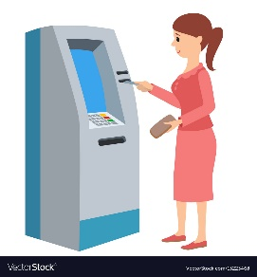

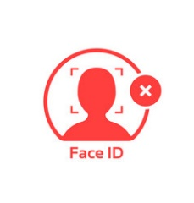
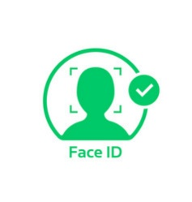


System Architecture
Bank Server
Dispatch to Account Holder
Captured Face
Generate ATM ID
Enrol Account Holder Face
Account Creation
Face Verification
Login
AH
Transaction
Bank
Unknown Face Forwarder Link
Account Holder
Bank Security Protocol

Slide 11
Module 1. ATM Simulator
The ATM Simulator is designed to replicate the functionalities of a physical Automated Teller Machine. The User Authentication Module ensures secure access by validating user credentials and verifying Personal Identification Numbers (PINs).
The Account Overview Module provides users with a snapshot of their accounts, displaying balances and recent transactions.
Additional modules include Change PIN for security updates, Transaction History for a detailed record of activities, and Card Management for actions like blocking or unblocking cards.
The Alerts and Notifications Module keeps users informed of account activities, while the Settings Module enables customization of preferences.Together, these modules create a comprehensive and realistic ATM simulation experience for users and developers alike.

Slide 12
Module 2. End User Interface
2.1. ATM System
Cardholder Interaction
Upon inserting their ATM card into the interface, users kick-start transactions. The system promptly reads the card details to facilitate seamless transaction processing.
Facial Recognition
Simultaneously, the system employs advanced facial recognition technology to capture the user's face. This captured image is then meticulously compared with the pre-trained face model stored in the system's database.
Security Measures
In scenarios where a facial match is identified, the transaction proceeds effortlessly. However, in cases of non-matching faces, the system activates additional security measures to safeguard the transaction.

Slide 13
Face Verification Link
For added security, the system generates a Face Verification Link. This link is promptly dispatched to the mobile number linked to the card account, ensuring an extra layer of identity confirmation.
User Approval Process
The cardholder, upon receiving the Face Verification Link, is prompted to verify their identity. Once approval is granted, the ATM dispenses the requested amount; if not, the system securely retrieves the card to prevent unauthorized access.

Slide 14
Module 3. Face Recognition
3.1. Dataset Creation
Account Holder Face by Recording Live Video for 30secs
The process begins with actively creating a comprehensive dataset by recording a live video of the account holder's face for approximately 30 seconds.
Frame Conversion
Post dataset acquisition, the system seamlessly converts video frames into individual images. This step is pivotal for simplifying subsequent image processing and analysis. It enables the system to work with discrete frames, facilitating more efficient handling and manipulation during pre-processing.

Slide 15
Module 3. Face Recognition
3.2. Pre-processing
This pre-processing module encompasses multiple steps to optimize images for subsequent analysis.
Grey Scale Conversion: The conversion to greyscale simplifies image representation, reducing complexity.
Noise Filter: The application of mean or Gabor filtering minimizes noise, enhancing the clarity of facial features.
Binarize: Converting images to binary format further streamlines feature extraction. These steps collectively contribute to creating a standardized and enhanced image dataset.

Slide 16
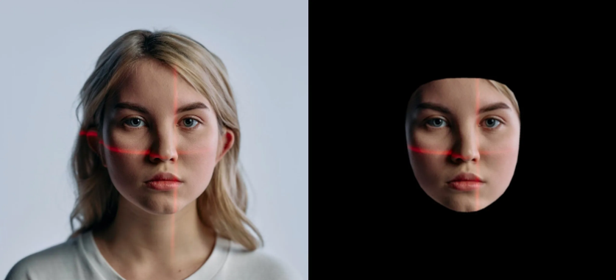
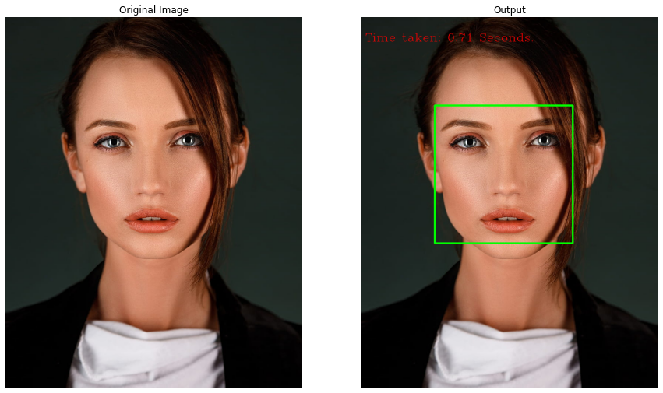
Module 3. Face Recognition
3.3. Face Detection
Leveraging a Region Proposal Network (RPN), this module identifies potential face regions within the pre-processed images. RPN excels at proposing regions likely to contain facial features, laying the groundwork for subsequent processing. It streamlines the computational effort by focusing on regions of interest, enhancing efficiency in face recognition.

Slide 17
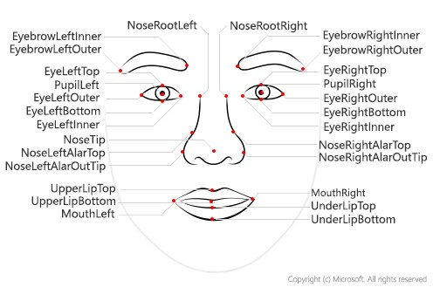
Module 3. Face Recognition
3.4. Face Feature Extraction
This module focuses on extracting relevant features from the detected face regions using Gray Level Co-occurrence Matrix (GLCM). GLCM captures statistical information about pixel intensity relationships, offering a rich set of features for subsequent classification. It serves as a robust method for characterizing facial textures and patterns.

Slide 18
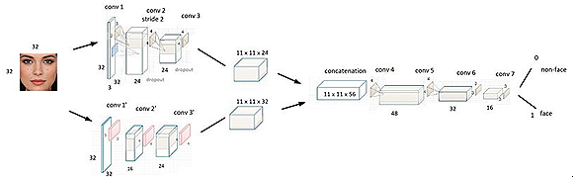
Module 3. Face Recognition
3.5. Classification using CNN (Convolutional Neural Network)
Employing a Convolutional Neural Network (CNN), this module classifies the extracted face features. The CNN is trained on the dataset, learning intricate patterns and representations crucial for accurate face recognition. The hierarchical structure of a CNN enables it to automatically learn discriminative features from the input images.

Slide 19
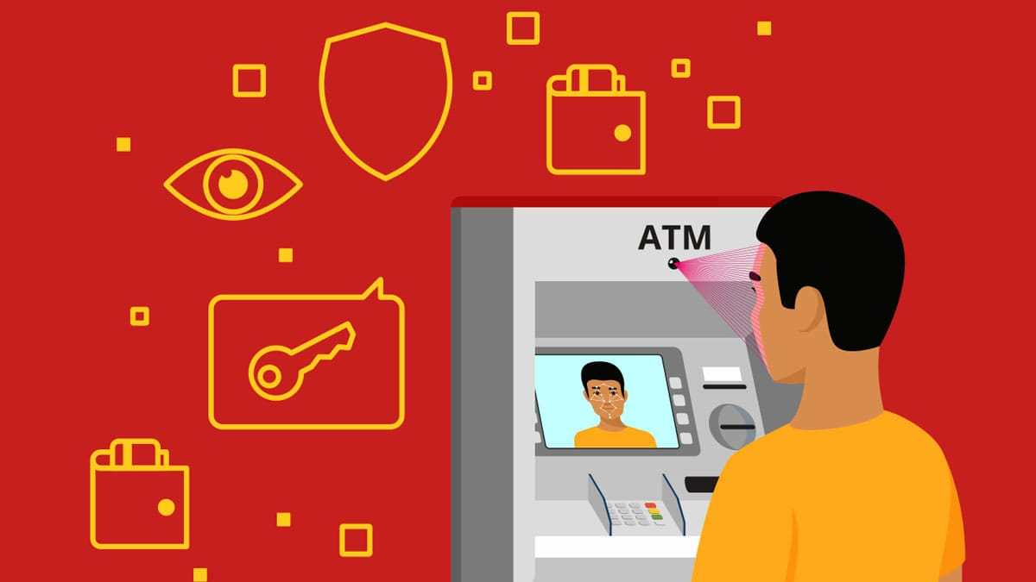
Module 4. Face Identification
4.1. ATM Captures User's Face
The Face Identification module commences with the ATM employing integrated cameras or sensors to capture a live image of the user's face during a transaction. This process is crucial for obtaining a real-time representation of the user's facial features, capturing nuances such as facial expressions, contours, and unique identifiers.

Slide 20
Module 4. Face Identification
4.2. Identify Users with Trained Model
The crux of the Face Identification module lies in the identification process, where the extracted facial features are compared with a pre-trained face identification model.
It has learned to recognize and differentiate specific individuals based on their unique facial characteristics.
Prediction Process: In real-time identification, the extracted features are compared with the patterns stored in the pre-trained model.
Authorization Decision: The identification process ultimately influences an authorization decision, determining whether the user is authorized to proceed with the requested transaction.

Slide 21
Module 5. Face Verification Link Generator
5.1. Generate Face Verification Link
In response to non-matching faces, the system promptly generates a Face Verification Link. This link is designed to serve as a secure and temporary reference for the user's facial profile, introducing an extra layer of security for subsequent verification steps.
5.2. Link Transmission to User's Mobile Number
The Face Verification Link is swiftly transmitted to the user's mobile number, enhancing security by sending the link to the device associated with the authorized account holder. This proactive step ensures that the user is promptly informed and involved in the verification process.

Slide 22
Module 6. Face Verification Process
Upon receiving the Face Verification Link, the authorized account holder engages in a secure and user-friendly process to validate the user at the ATM. The following steps outline the Face Verification Process:
6.1. Link Access and View User
The authorized account holder receives the Face Verification Link on their mobile device. By clicking the link, they are directed to a secure page displaying the captured image of the user at the ATM.
6.2. User Approval
After viewing the user's image, the authorized account holder has the option to approve the user's identity. This approval step is crucial for authorizing the subsequent transaction and confirming that the individual at the ATM is indeed the legitimate account holder.

Slide 23
Module 6. Face Verification Process
6.3. Enter Amount and PIN
Upon approving the user, the account holder proceeds to enter the desired withdrawal amount and their unique Personal Identification Number (PIN). This step confirms their intention to proceed with the transaction.
6.4. Confirmation and Money Dispensation
With the entered amount and PIN, the account holder confirms the transaction. The ATM machine, recognizing the approved user, dispenses the requested amount of money.
6.5. Unknown User Handling
In the event that the user at the ATM is unrecognized or deemed unauthorized, the account holder has the option to take immediate action. This may include blocking the user directly through the link interface, enhancing security measures against potential fraudulent activities.

Slide 24
System Specifications
Operating System: Windows 10 or higher
Python: Version 3.7 or higher
Flask: Version 2.0 or higher
MySQL: Version 8.0 or higher
Python Packages: Numpy, Pandas, Matplotlib, and Scikit-learn
Web Server: Apache Web Server (in WampServer)

Slide 25
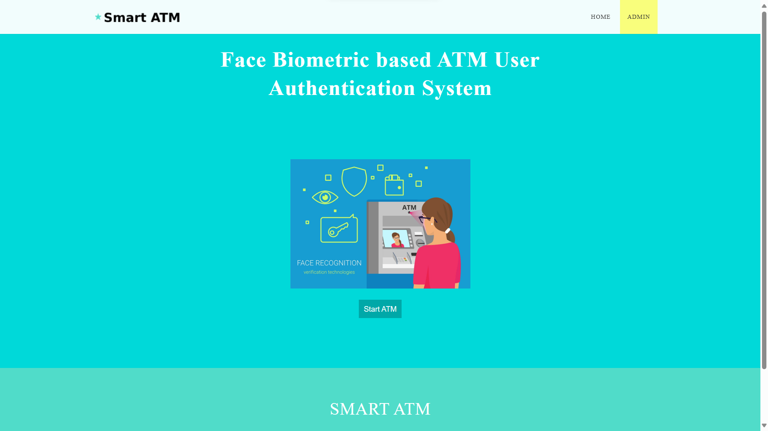
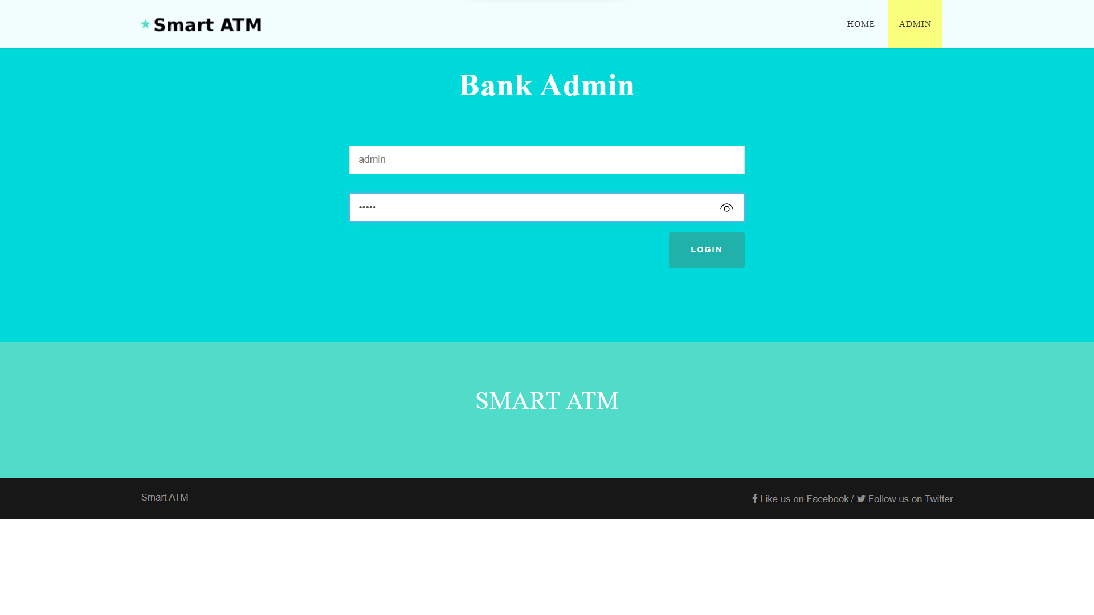
Screenshot

Slide 26
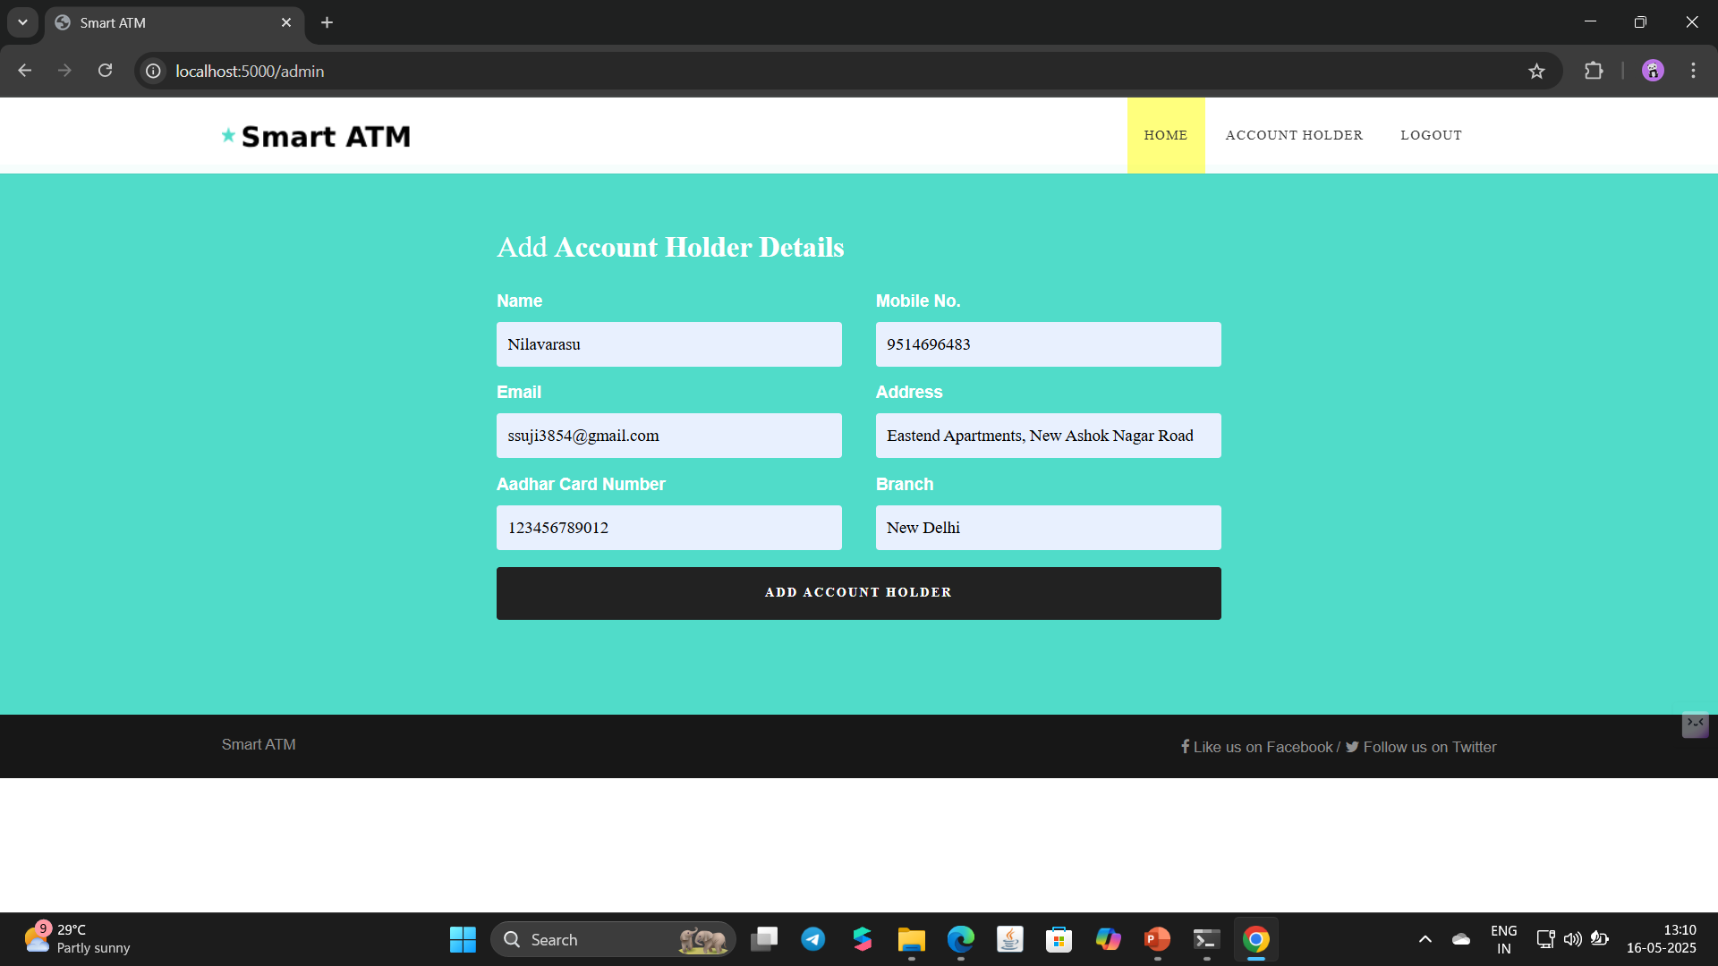
Screenshot

Slide 27
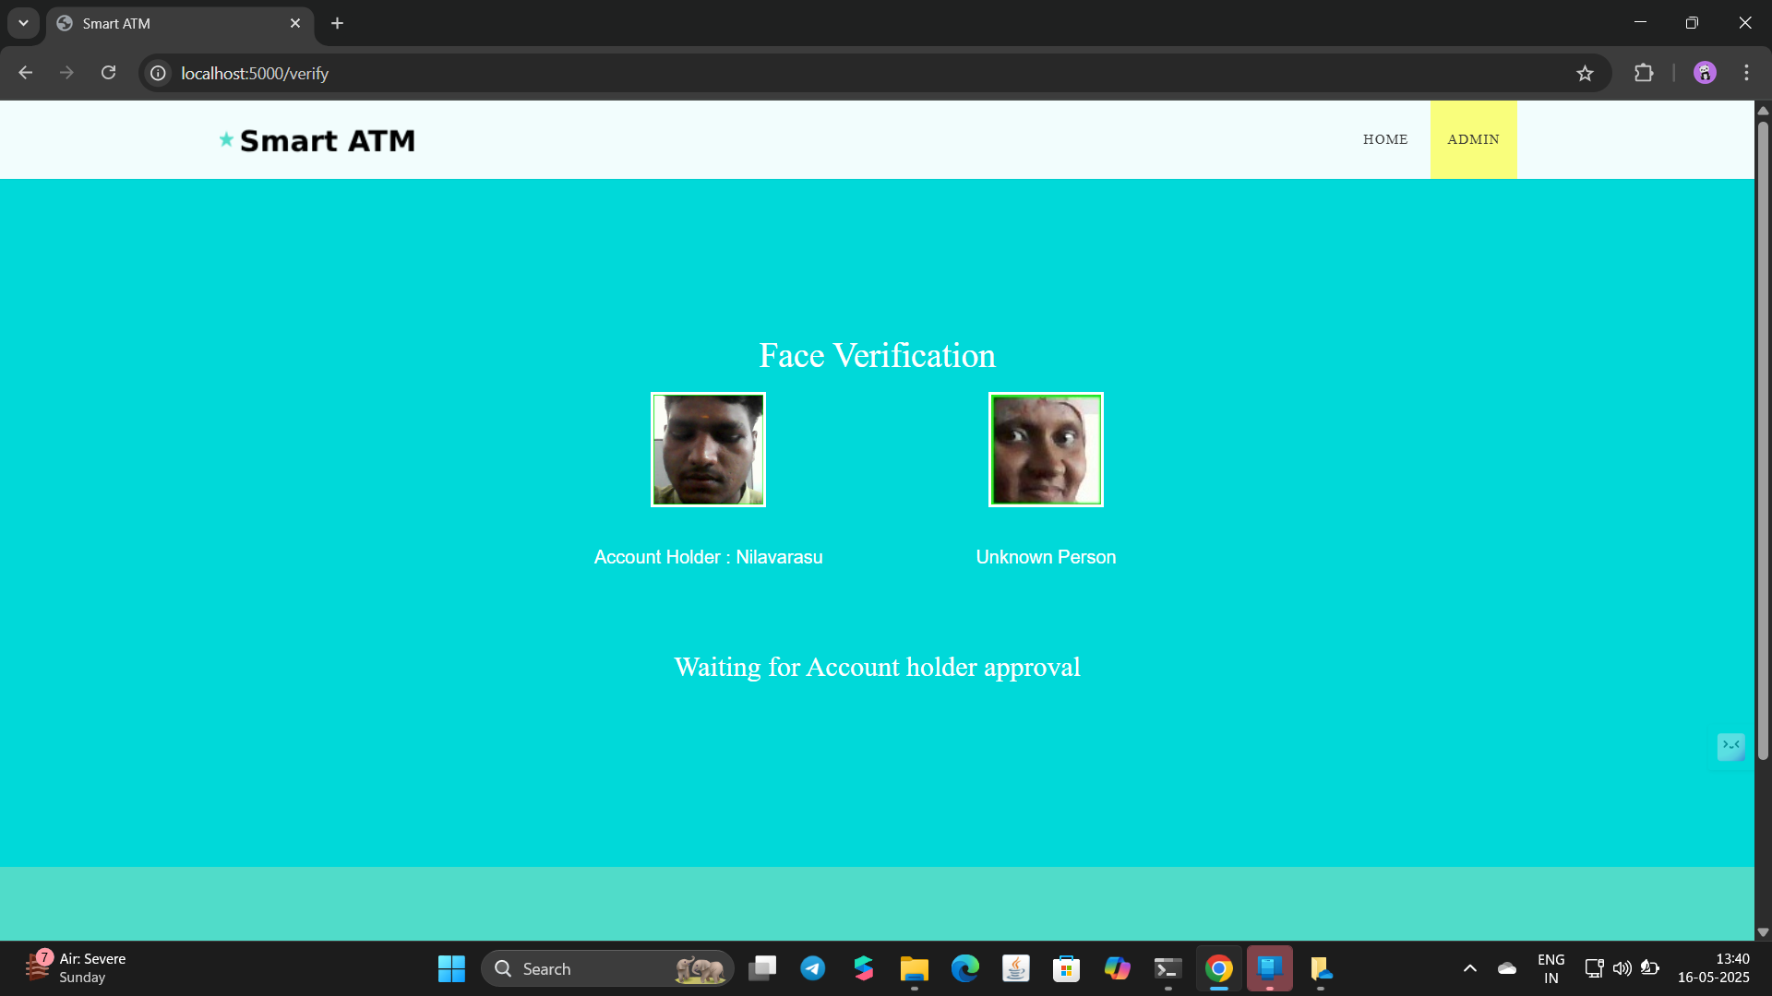
Screenshot

Slide 28
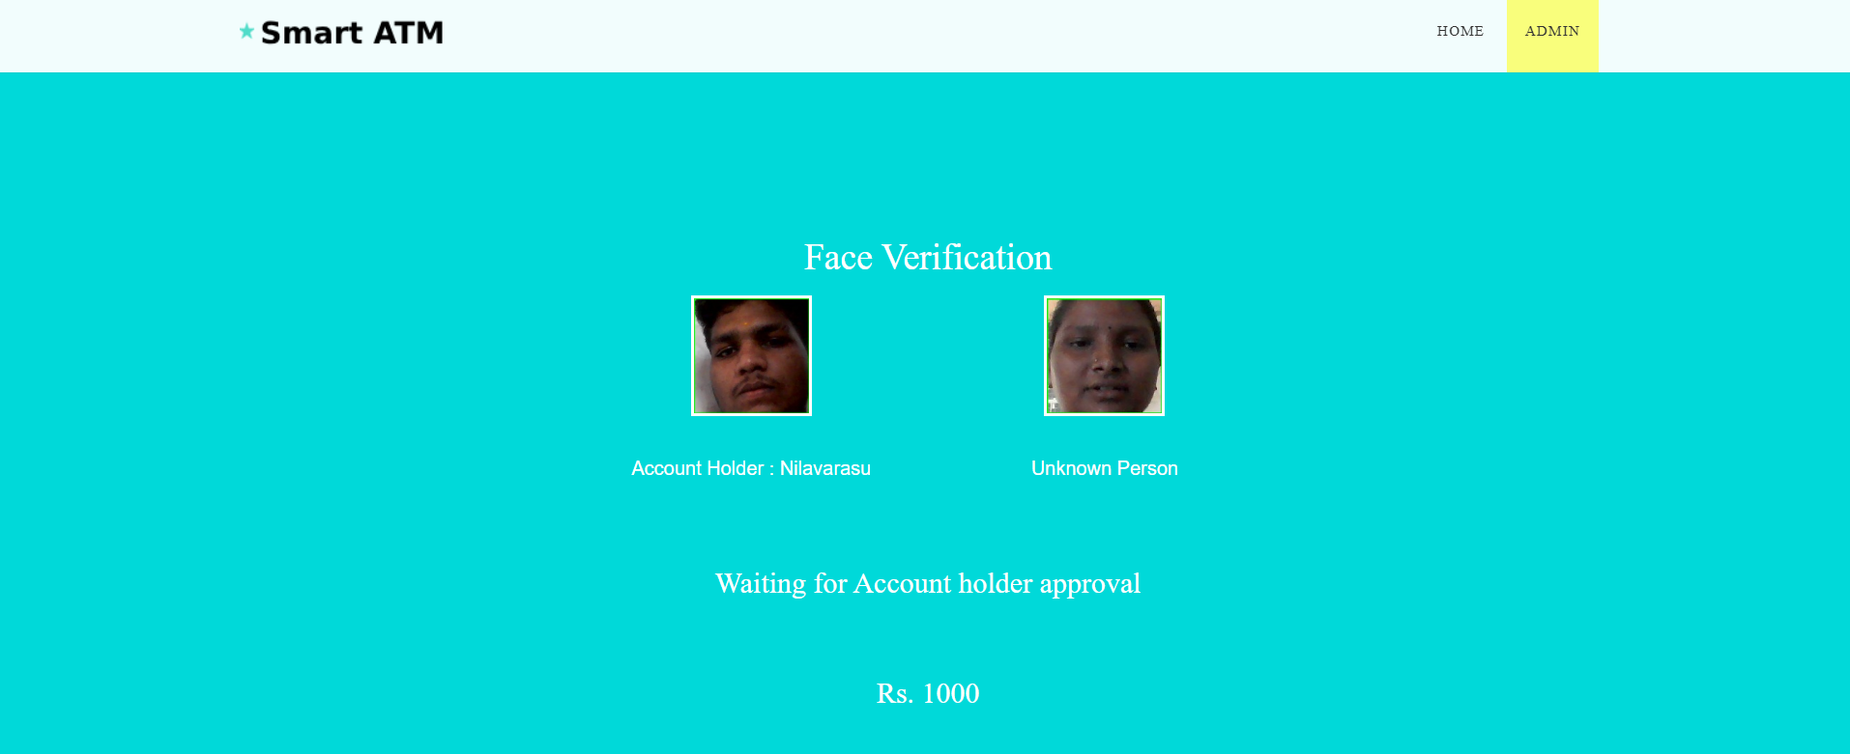
Screenshot WithDraw

Slide 29
Future Enhancement
Multi-factor authentication: The system could be expanded to support multi-factor authentication, requiring users to provide additional forms of authentication in addition to facial recognition, such as a password or a fingerprint scan.
Real-time alerts: The system could be configured to send real-time alerts to bank administrators or security personnel in the event of a security breach or suspicious activity.
Integration with mobile banking: The system could be integrated with mobile banking applications to enable users to perform transactions and account management tasks using their mobile devices.
Support for multiple languages: The system could be expanded to support multiple languages, making it more accessible to users who are not fluent in the system's default language.

Slide 30
Conclusion
In conclusion, This project can overcome the issue of impersonation of a cardholder. This is like a two factor authentication method which is used to confirm that the transaction is done by the card owner or the persons trusted by the owner using face recognition. It limits the card usage of the unauthorized users who hold the password of someone’s card. Thus, this ATM model provides security against exploitation of identity, by using a verification system using face recognition to the identity and confirm the user and it will scale back forced transactions to an excellent extent.

Slide 31
References
1. Sri Vasu, Subash, Sharmila Rani, Udhayakumar,ATM Security using Machine Learning techniques in IOT, International Journal of Advance Research, Ideas and
Innovations in Technology, Volume 5, Issue 2, pp. 150-153, 2019.
2. M.Murugesan,S.Thilagamani, Overview Of Techniques For Face Recognition, International Journal Of Life Science and Pharma Reviews , pp.66 - 71 , 2019 ,
ISSN 2250 – 0480.
3. H.R.Babaei, O.Molalapata and A.A.Pandor, Face Recognition Application for Automatic Teller Machines (ATM), in ICIKM, 3rdvol.45, November –
December 2012, pp.211-216.

Slide 32


